Slide 1
Clustering

Slide 2
Clustering
It is basically a type of unsupervised learning method .
Clustering or cluster analysis is a machine learning technique, which groups the unlabelled dataset
It can be defined as "A way of grouping the data points into different clusters, consisting of similar data points. The objects with the possible similarities remain in a group that has less or no similarities with another group."
The clustering technique is commonly used for statistical data analysis.

Slide 3
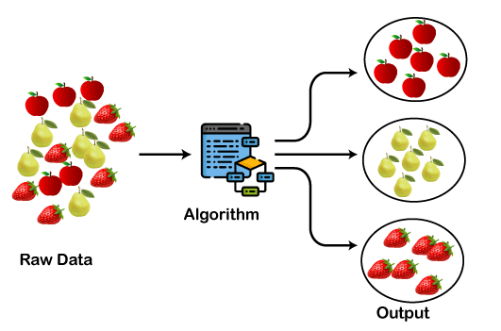
Clustering

Slide 4
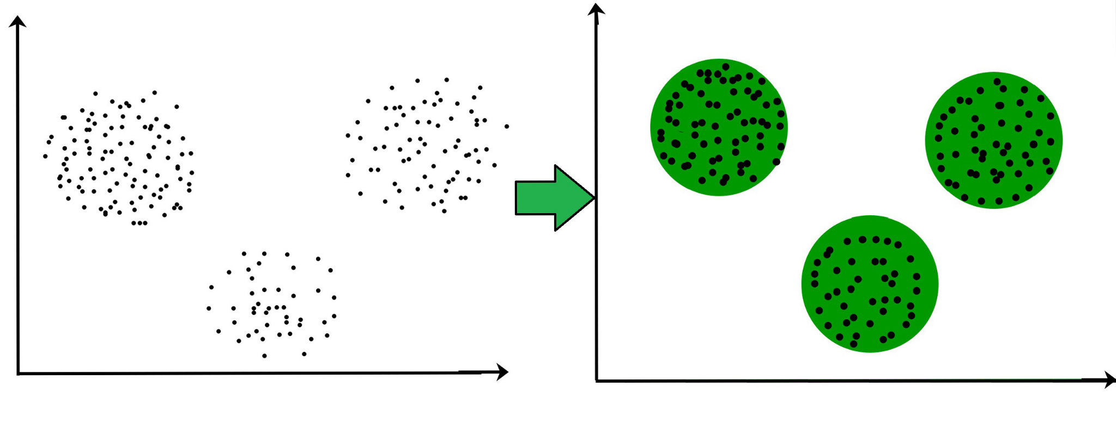
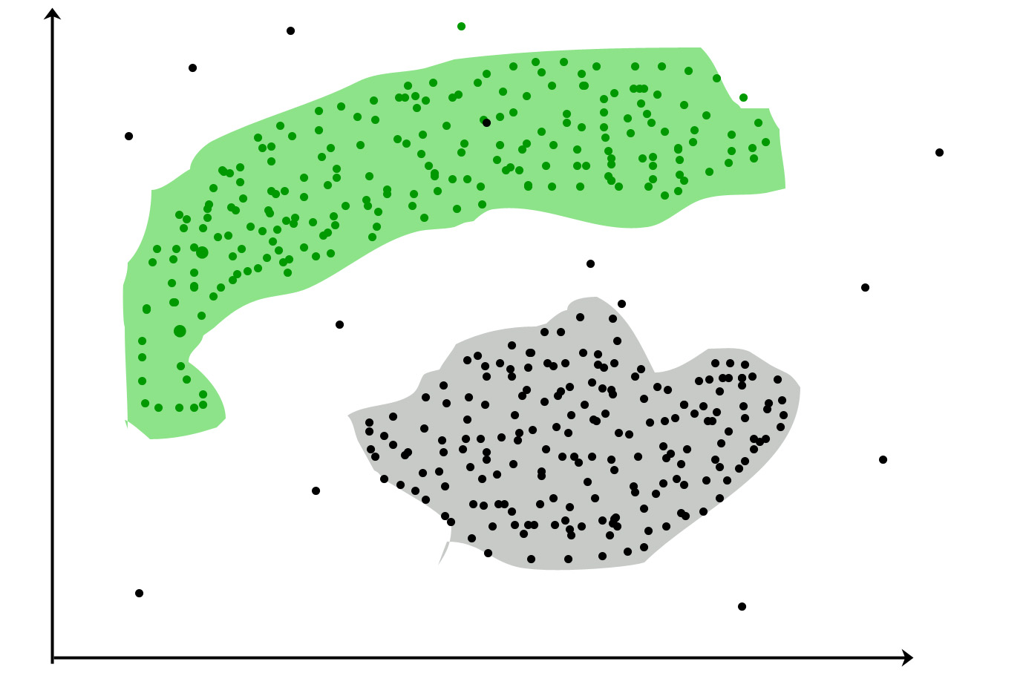
Clusters
Real-world example
Shopping mall

Slide 5
Clustering
The clustering technique can be widely used in various tasks
Market Segmentation
Statistical data analysis
Social network analysis
Image segmentation
Anomaly detection, etc.
it is used by the Amazon in its recommendation system to provide the recommendations as per the past search of products.
Netflix also uses this technique to recommend the movies and web-series to its users as per the watch history.

Slide 6
Types of Clustering Methods
The clustering methods are broadly divided into two main subgroups
Hard Clustering: In hard clustering, each data point either belongs to a cluster completely or not.
Soft Clustering: In soft clustering, instead of putting each data point into a separate cluster, a probability or likelihood of that data point to be in those clusters is assigned.

Slide 7
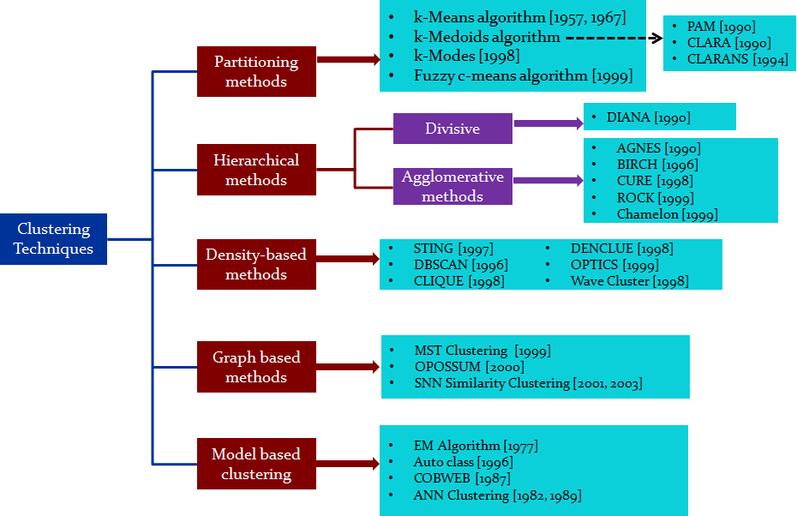

Slide 8
Clustering Distance Measures
The classification of observations into groups requires some methods for computing the distance or the (dis)similarity between each pair of observations. The result of this computation is known as a dissimilarity or distance matrix.
There are many methods to calculate this distance information
The choice of distance measures is a critical step in clustering. It defines how the similarity of two elements (x, y) is calculated and it will influence the shape of the clusters.

Slide 9


Clustering Distance Measures
The classical methods for distance measures are Euclidean and Manhattan distances, which are defined as follow:
Euclidean distance:
Manhattan distance:
Where, x and y are two vectors of length n.

Slide 10
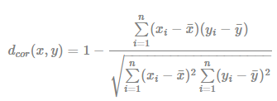
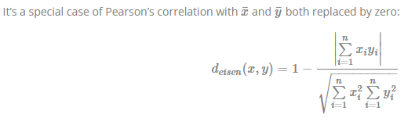
Clustering Distance Measures
Other dissimilarity measures exist such as correlation-based distances, which is widely used for gene expression data analyses. Correlation-based distance is defined by subtracting the correlation coefficient from 1. Different types of correlation methods can be used such as:
Pearson correlation distance: Pearson correlation measures the degree of a linear relationship between two profiles.
Eisen cosine correlation distance :

Slide 11
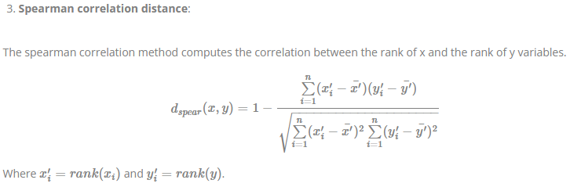
Clustering Distance Measures

Slide 12
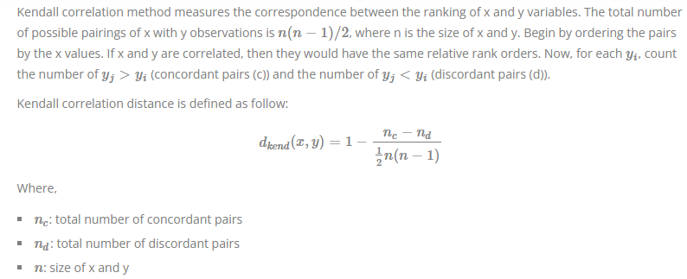
Clustering Distance Measures
4. Kendall correlation distance:

Slide 13
Clustering Distance Measures
Note that,
Pearson correlation analysis is the most commonly used method. It is also known as a parametric correlation which depends on the distribution of the data.
Kendall and Spearman correlations are non-parametric and they are used to perform rank-based correlation analysis.

Slide 14
What type of distance measures should we choose?
The choice of distance measures is very important, as it has a strong influence on the clustering results. For most common clustering software, the default distance measure is the Euclidean distance.
Depending on the type of the data and the researcher questions, other dissimilarity measures might be preferred. For example, correlation-based distance is often used in gene expression data analysis.
Correlation-based distance considers two objects to be similar if their features are highly correlated, even though the observed values may be far apart in terms of Euclidean distance. The distance between two objects is 0 when they are perfectly correlated.
Pearson’s correlation is quite sensitive to outliers. This does not matter when clustering samples, because the correlation is over thousands of genes. When clustering genes, it is important to be aware of the possible impact of outliers. This can be mitigated by using Spearman’s correlation instead of Pearson’s correlation.

Slide 15
What type of distance measures should we choose?
If we want to identify clusters of observations with the same overall profiles regardless of their magnitudes, then we should go with correlation-based distance as a dissimilarity measure.
This is particularly the case in gene expression data analysis, where we might want to consider genes similar when they are “up” and “down” together. It is also the case, in marketing if we want to identify group of shoppers with the same preference in term of items, regardless of the volume of items they bought.
If Euclidean distance is chosen, then observations with high values of features will be clustered together. The same holds true for observations with low values of features.

Slide 16
Types of Clustering algorithms/methods/techniques
Below are the main clustering algorithms used in Machine learning:
Partitioning Clustering : K Means
Density-Based Clustering : DB Scan
Hierarchical Clustering
Grid based clustering
Graph Based clustering : Minimal Spanning Tree
Model Based clustering : Expectation Maximization

Slide 17
Model Based clustering :- Expectation Maximization Algorithm
EM Algorithm
EM Algorithm Numerical

Slide 18
Density Based Algorithm :
DB Scan

Slide 19
Graph Based Clustering : Minimal Spanning Tree
Minimal Spanning Tree Numerical

Slide 20
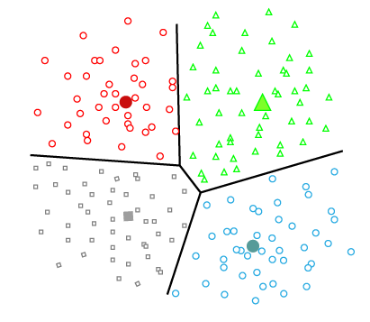
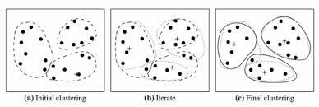
Partitioning Clustering
These methods partition the objects into k clusters and each partition forms one cluster. It is also known as the centroid-based method.This method is used to optimize an objective criterion similarity function such as when the distance is a major parameter example K-means, CLARANS (Clustering Large Applications based upon Randomized Search) etc.
In this type, the dataset is divided into a set of k groups(k<=n) in ‘n’ number of datapoints , where K is used to define the number of pre-defined groups.
The cluster center is created in such a way that the distance between the data points of one cluster is minimum as compared to another cluster centroid.
Iterative relocation to improve partitioning
Most of the partitioning methods are distance based
Computationally expensive

Slide 21
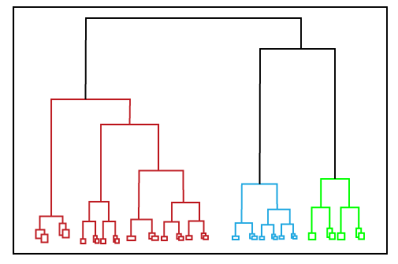
Hierarchical Clustering
Hierarchical clustering can be used as an alternative for the partitioned clustering as there is no requirement of pre-specifying the number of clusters to be created.
In this technique, the dataset is divided into clusters to create a tree-like structure, which is also called a dendrogram.
The observations or any number of clusters can be selected by cutting the tree at the correct level.
There are two approaches:
Agglomerative (bottom up approach)
Divisive (top down approach)

Slide 22
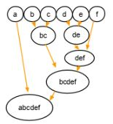
Agglomerative
In agglomerative clustering, there is a bottom-up approach. We begin with each element as a separate cluster and merge them into successively more massive clusters, as shown below:

Slide 23
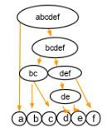
Divisive clustering
Divisive clustering is a top-down approach. We begin with the whole set and proceed to divide it into successively smaller clusters, as you can see below:

Slide 24
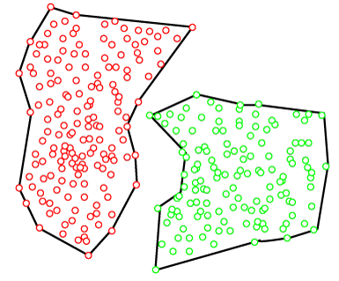
Density-Based Clustering
The density-based clustering method connects the highly-dense areas into clusters, and the arbitrarily shaped distributions are formed as long as the dense region can be connected. This algorithm does it by identifying different clusters in the dataset and connects the areas of high densities into clusters. The dense areas in data space are divided from each other by sparser areas.
These algorithms can face difficulty in clustering the data points if the dataset has varying densities and high dimensions.
It uses the concept of density reachability and density connectivity

Slide 25
Grid based Clustering
The grid-based clustering approach uses a multiresolution grid data structure.
It quantizes the object space into a finite number of cells that form a grid structure on which all of the operations for clustering are performed.
The main advantage of the approach is its fast processing time, which is typically independent of the number of data objects, yet dependent on only the number of cells

Slide 26
Partitioning Approach : K-Means Algorithm Work
Step-1: Select the number K to decide the number of clusters.
Step-2: Select random K points or centroids. (It can be other from the input dataset).
Step-3: Assign each data point to their closest centroid, which will form the predefined K clusters.
Step-4: Calculate the variance and place a new centroid of each cluster.
Step-5: Repeat the third steps, which means assign each datapoint to the new closest centroid of each cluster.
Step-6: If any reassignment occurs, then go to step-4 else go to FINISH.
Step-7: The model is ready.

Slide 27
K-means algorithm problem
K Means Numerical

Slide 28
DBSCAN ( Density-Based Spatial Clustering of Applications with Noise )
Unsupervised learning/ clustering technique
Used widely across domains and industries (think about Uber’s route optimization, Amazon’s recommendation system, Netflix’s customer segmentation, and so on)
K-Means and Hierarchical Clustering both fail in creating clusters of arbitrary shapes. They are not able to form clusters based on varying densities. they are suitable only for compact and well-separated clusters. Moreover, they are also severely affected by the presence of noise and outliers in the data.
Hence DBSCAN clustering is needed
proposed by Martin Ester et al. in 1996
density-based clustering algorithm that works on the assumption that clusters are dense regions in space separated by regions of lower density.

Slide 29
DBSCAN (Density-Based Spatial Clustering of Applications with Noise)
It groups ‘densely grouped’ data points into a single cluster.
It can identify clusters in large spatial datasets by looking at the local density of the data points.
The most important feature of DBSCAN clustering is that it is robust to outliers.
It also does not require the number of clusters to be told beforehand, unlike K-Means, where we have to specify the number of centroids.
DBSCAN requires only two parameters: epsilon and minPoints.
Epsilon is the radius of the circle to be created around each data point to check the density and minPoints is the minimum number of data points required inside that circle for that data point to be classified as a Core point

Slide 30
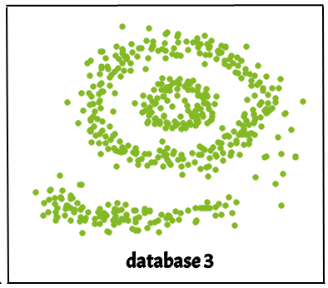
DBSCAN (Density-Based Spatial Clustering of Applications with Noise)
Real life data may contain irregularities, like:
Clusters can be of arbitrary shape as shown .
Data may contain noise.
DBSCAN algorithm requires two parameters:
eps : It defines the neighborhood around a data point i.e. if the distance between two points is lower or equal to ‘eps’ then they are considered neighbors. If the eps value is chosen too small then large part of the data will be considered as outliers. If it is chosen very large then the clusters will merge and the majority of the data points will be in the same clusters. One way to find the eps value is based on the k-distance graph.
MinPts: Minimum number of neighbors (data points) within eps radius. Larger the dataset, the larger value of MinPts must be chosen. As a general rule, the minimum MinPts can be derived from the number of dimensions D in the dataset as, MinPts >= D+1. The minimum value of MinPts must be chosen at least 3.

Slide 31
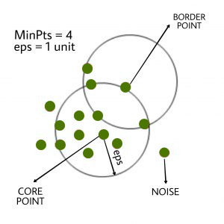
DBSCAN (Density-Based Spatial Clustering of Applications with Noise)
In this algorithm, we have 3 types of data points.
Core Point: A point is a core point if it has more than MinPts points within eps.
Border Point: A point which has fewer than MinPts within eps but it is
in the neighborhood of a core point.
Noise or outlier: A point which is not a core point or
border point.

Slide 32
DBSCAN (Density-Based Spatial Clustering of Applications with Noise)
DBSCAN algorithm can be abstracted in the following steps:
Find all the neighbor points within eps and identify the core points or visited with more than MinPts neighbors.
For each core point if it is not already assigned to a cluster, create a new cluster.
Find recursively all its density connected points and assign them to the same cluster as the core point. A point a and b are said to be density connected if there exist a point c which has a sufficient number of points in its neighbors and both the points a and b are within the eps distance. This is a chaining process. So, if b is neighbor of c, c is neighbor of d, d is neighbor of e, which in turn is neighbor of a implies that b is neighbor of a.
Iterate through the remaining unvisited points in the dataset. Those points that do not belong to any cluster are noise.

Slide 33
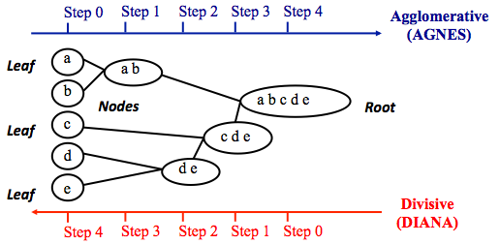
Hierarchical clustering/ Hierarchical cluster analysis(HCA)
Agglomerative clustering works in a “bottom-up” manner. That is, each object is initially considered as a single-element cluster (leaf). At each step of the algorithm, the two clusters that are the most similar are combined into a new bigger cluster (nodes). This procedure is iterated until all points are member of just one single big cluster (root)
The inverse of agglomerative clustering is divisive clustering, which is also known as DIANA (Divise Analysis) and it works in a “top-down” manner. It begins with the root, in which all objects are included in a single cluster. At each step of iteration, the most heterogeneous cluster is divided into two. The process is iterated until all objects are in their own cluster

Slide 34
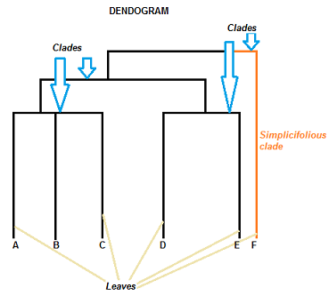
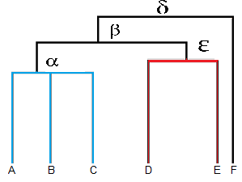
Dendrogram
The clade is the branch. Usually labeled with Greek letters from left to right (e.g. α β, δ…).
Each clade has one or more leaves. The leaves in the above image are:
Single (simplicifolius): F
Double (bifolius): D E
Triple (trifolious): A B C
A dendrogram is a type of tree diagram showing hierarchical clustering relationships between similar sets of data.
A dendrogram can be a column graph (as in the image) or a row graph.
The clades are arranged according to how similar (or dissimilar) they are.
Clades that are close to the same height are similar to each other; clades with different heights are dissimilar — the greater the difference in height, the more dissimilarity

Slide 35
Dendrogram
Leaves A, B, and C are more similar to each other than they are to leaves D, E, or F.
Leaves D and E are more similar to each other than they are to leaves A, B, C, or F.
Leaf F is substantially different from all of the other leaves.

Slide 36
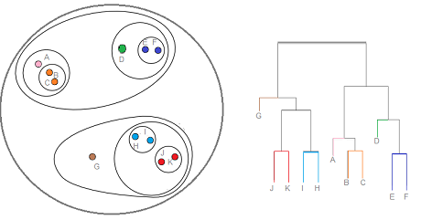
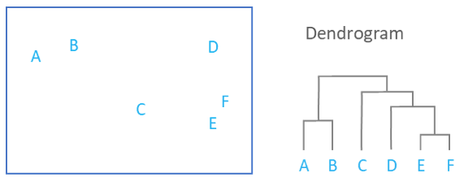
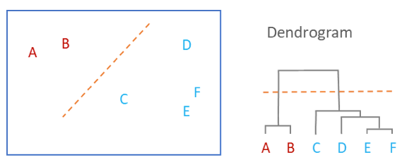
Dendrogram

Slide 37
Hierarchical clustering/ Hierarchical cluster analysis(HCA)
To measure the dissimilarity between two clusters of observations a number of different cluster agglomeration methods (i.e, linkage methods) have been developed.The most common types methods are:
Maximum or complete linkage clustering: It computes all pairwise dissimilarities between the elements in cluster 1 and the elements in cluster 2, and considers the largest value (i.e., maximum value) of these dissimilarities as the distance between the two clusters. It tends to produce more compact clusters.
Minimum or single linkage clustering: It computes all pairwise dissimilarities between the elements in cluster 1 and the elements in cluster 2, and considers the smallest of these dissimilarities as a linkage criterion. It tends to produce long, “loose” clusters.
Mean or average linkage clustering: It computes all pairwise dissimilarities between the elements in cluster 1 and the elements in cluster 2, and considers the average of these dissimilarities as the distance between the two clusters.
Centroid linkage clustering: It computes the dissimilarity between the centroid for cluster 1 (a mean vector of length p variables) and the centroid for cluster 2.
Ward’s minimum variance method: It minimizes the total within-cluster variance. At each step the pair of clusters with minimum between-cluster distance are merged.

Slide 38
Hierarchical clustering : Agglomerative approach numericals
Agglomerative Numericals Link

Slide 39
Applications of Clustering
In Identification of Cancer Cells: The clustering algorithms are widely used for the identification of cancerous cells. It divides the cancerous and non-cancerous data sets into different groups.
In Search Engines: Search engines also work on the clustering technique. The search result appears based on the closest object to the search query. It does it by grouping similar data objects in one group that is far from the other dissimilar objects. The accurate result of a query depends on the quality of the clustering algorithm used.
Customer Segmentation: It is used in market research to segment the customers based on their choice and preferences.
In Biology: It is used in the biology stream to classify different species of plants and animals using the image recognition technique.

